Slide 1


Marathwada Mitra Mandal’s College of Engineering Permanently Affiliated to SPPU\Accredited with “A++” Grade by NAAC\Recipient of ‘Best college’ award by SPPU Accredited by NBA (Electrical and Mechanical Eng)\Recognized under 2(f) and 12(b) of UGC act 1956 \ ISO 9001:2015 Department of Computer Engineering
Group ID : P-22
Name of Guide : Reshma Kapadi
Title of BE-Project : Web based crawling to categorize website according to 'n' categories
Domain of Project : Machine Learning
Group Members :
1.Anish Harsule BC127
2.Deepti Pujari BC256
3.Yash Mahajan BC269

Slide 2
Index
Problem Statement
Introduction
Motivation
Objectives
Scope
Literature Survey
System Architecture
System Requirements
Diagrams
Implementation
Conclusion
References

Slide 3
Introduction
“Web-based Crawling for Dynamic Website Categorization using ML," integrates web crawling and ML algorithms to categorize websites in real-time, enhancing user security.
With a daily updated top-million website database, our system adapts to dynamic online changes, providing accurate categorization for effective network control policies.
This pioneering solution ensures a secure online environment by seamlessly combining crawling, ML, and network control mechanisms.

Slide 4
Motivation
Our project is motivated by the inadequacy of static categorization systems in coping with the dynamic internet landscape.
Through web-based crawling and machine learning, we offer real-time website categorization with a daily updated top million sites database, ensuring accuracy.
Additionally, our user-friendly GUI empowers users to input URLs, enhancing the overall user experience.

Slide 5
Problem Statement
Web based crawling to categorize website according to 'n' categories
The problem addressed by this project is the lack of a real-time, web-based crawling system that
utilizes daily updated data of the top million sites and employs machine learning (ML) algorithms to categorize user-entered URLs into 'n' predefined categories.

Slide 6
Objective
To Enhance Intelligent Website Categorization
To Improve Management of Dynamic Databases
To Promote User-Friendly Communication
To Improve MySQL Database Anchoring

Slide 7
Scope
Our project focuses on developing a robust web-based crawling system for dynamic website categorization.
Leveraging a daily updated top million sites database and machine learning algorithms, users can interact via a user-friendly GUI for real-time, accurate categorization.
The project's scope includes addressing the dynamic online landscape and empowering users with an efficient categorization tool.

Slide 8
Literature Survey
Paper | Year Of Publication | Published by | Abstract | Pros | Cons
Exploring Dark Web Crawlers: A Systematic Literature Review of Dark Web Crawlers and Their Implementation | 2023 | IEEE Access | Strong encryption algorithms and reliable anonymity routing have made cybercrime investigation more challenging. Hence, one option for law enforcement agencies (LEAs) is to search through unencrypted content on the Internet or anonymous communication networks (ACNs). The capability of automatically harvesting web content from web servers enables LEAs to collect and preserve data prone to serve as potential leads, clues, or evidence in an investigation. | It allows user interaction 2. It mimics human behavior well 3. It works visually and hence gives an investigator the option to watch as the crawler fetches each page; in this way, the process is ‘‘invigilated’’. | 1. The Dark Web is notorious for hosting illegal and harmful activities, including the sale of drugs, weapons, stolen data, etc. 2. Accessing and crawling the Dark Web may violate laws and regulations in certain jurisdictions.

Slide 9

System Requirements
SOFTWARE REQUIREMENTS
Python (programming language)
OSIRT (web browser)
FAW (web crawler)
BeautifulSoup
HARDWARE REQUIREMENTS
Laptop
Processor : Intel Core I4 and above
RAM : 4GB and above
Storage : 20 GB and above

Slide 10

Environmental tools
Linux
Visual Studio Code
MySQL Workbench
Jupyter Notebook

Slide 11
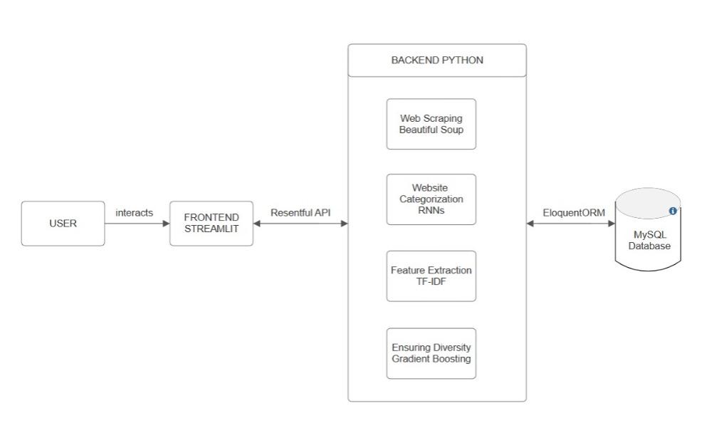
Architecture Diagram
Rest API

Slide 12
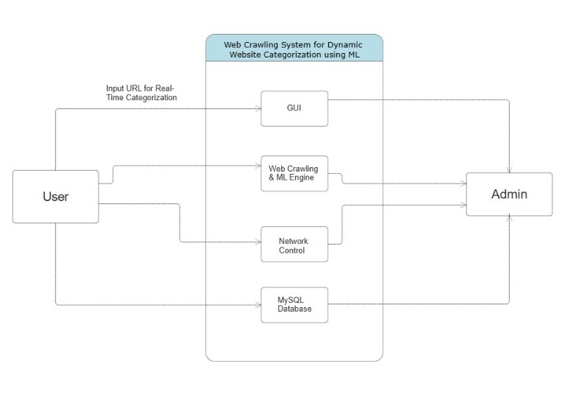
Data Flow Diagram.1

Slide 13
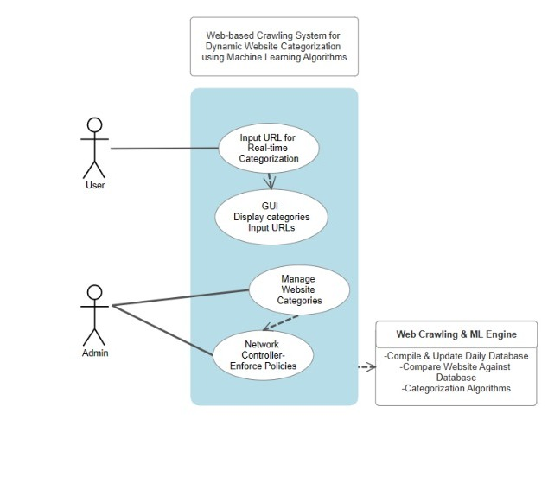
Use Case Diagram

Slide 14
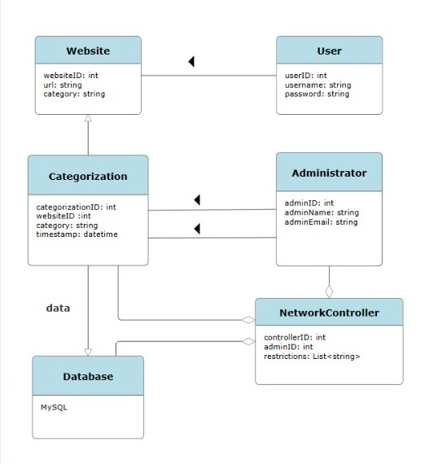
Class Diagram

Slide 15
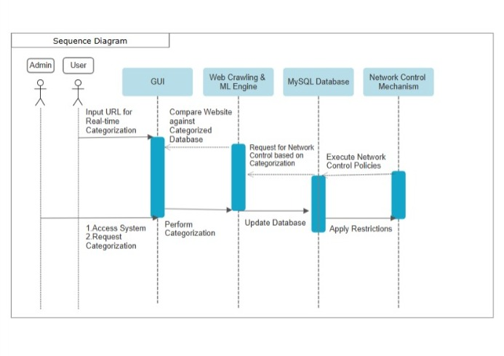
Sequence Diagram

Slide 16
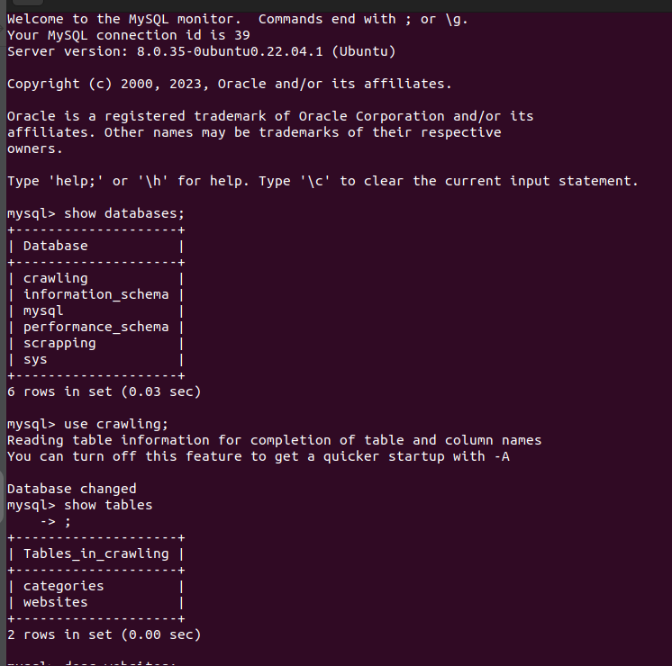
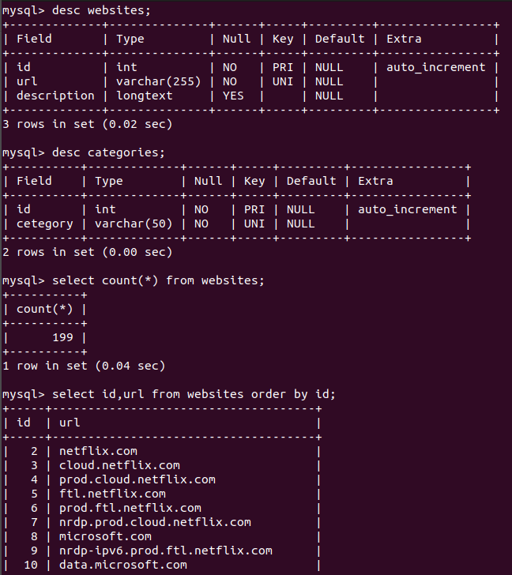
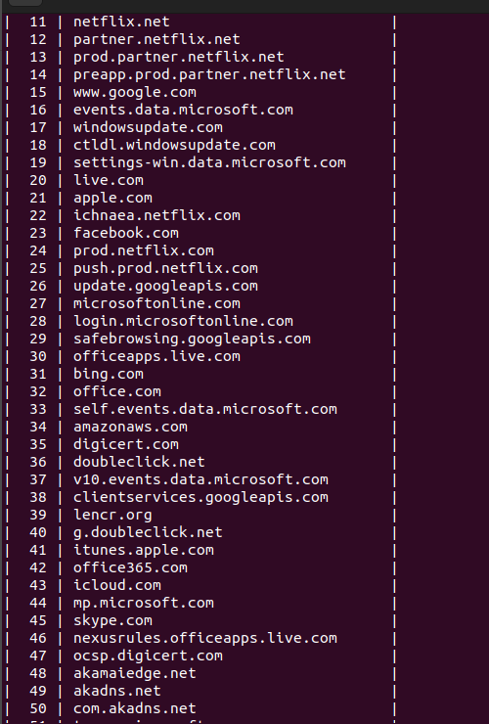
DATABASE CREATION

Slide 17
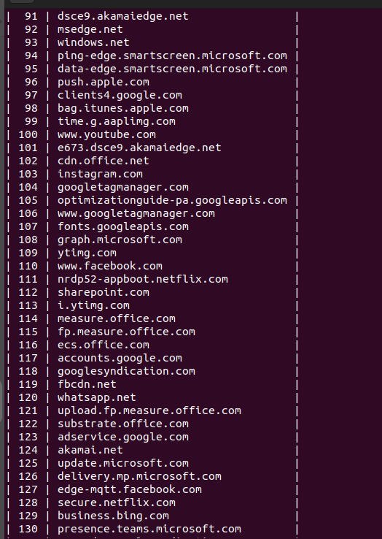
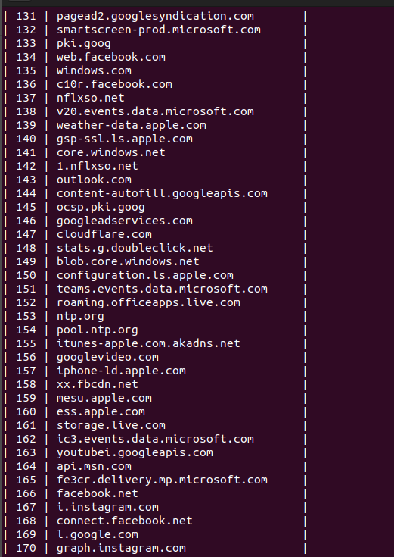
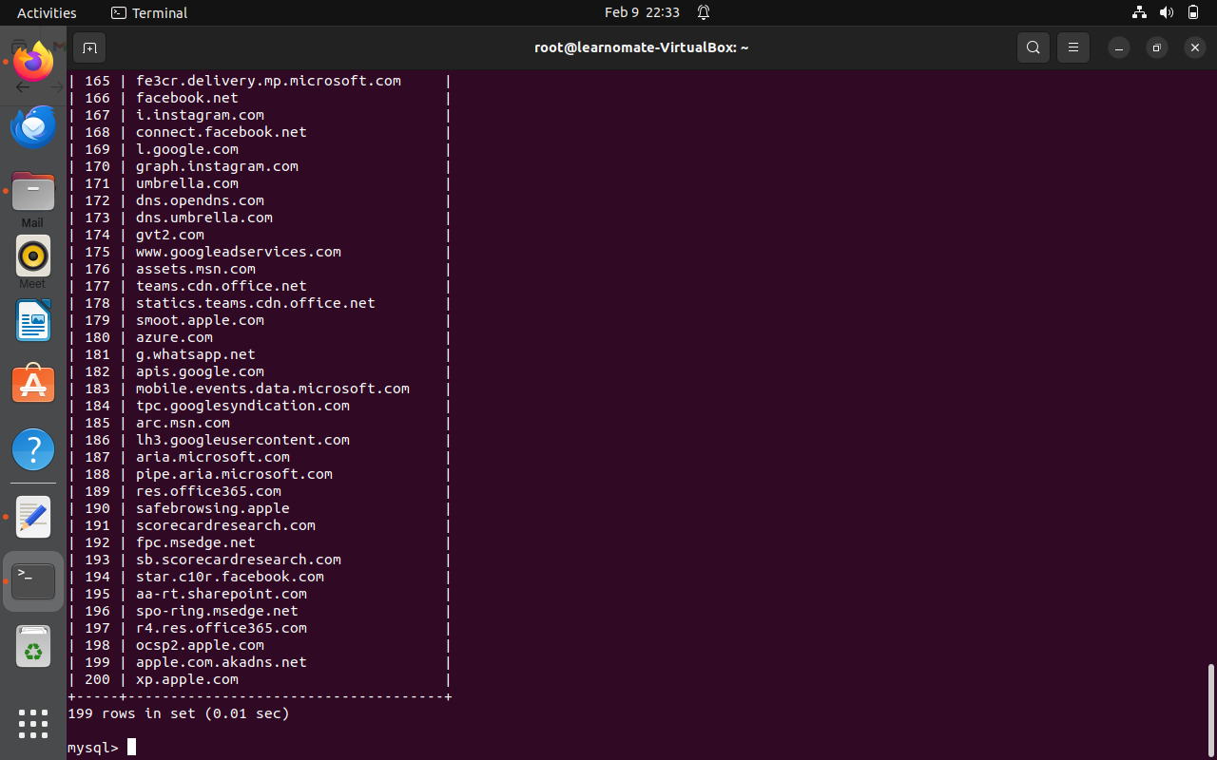
DATABASE CREATION

Slide 18
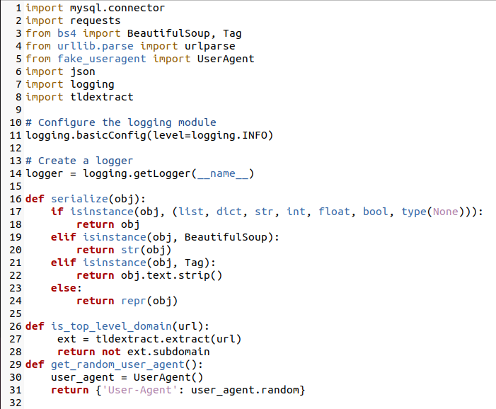
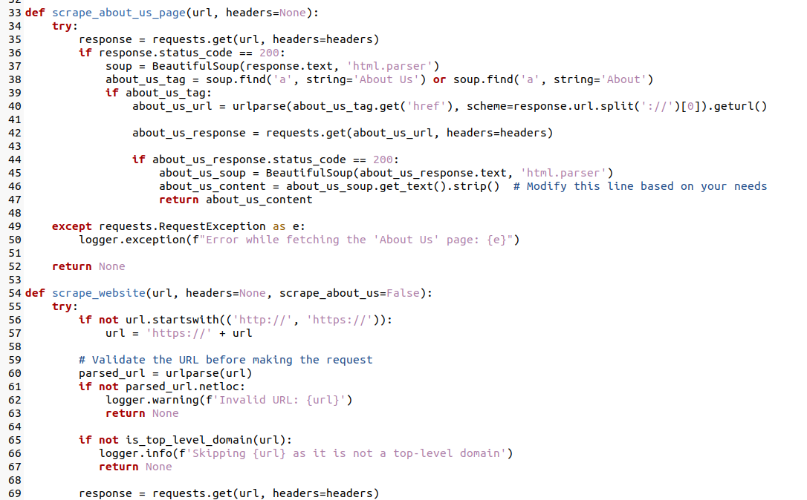
DATABASE CONNECTIVITY

Slide 19
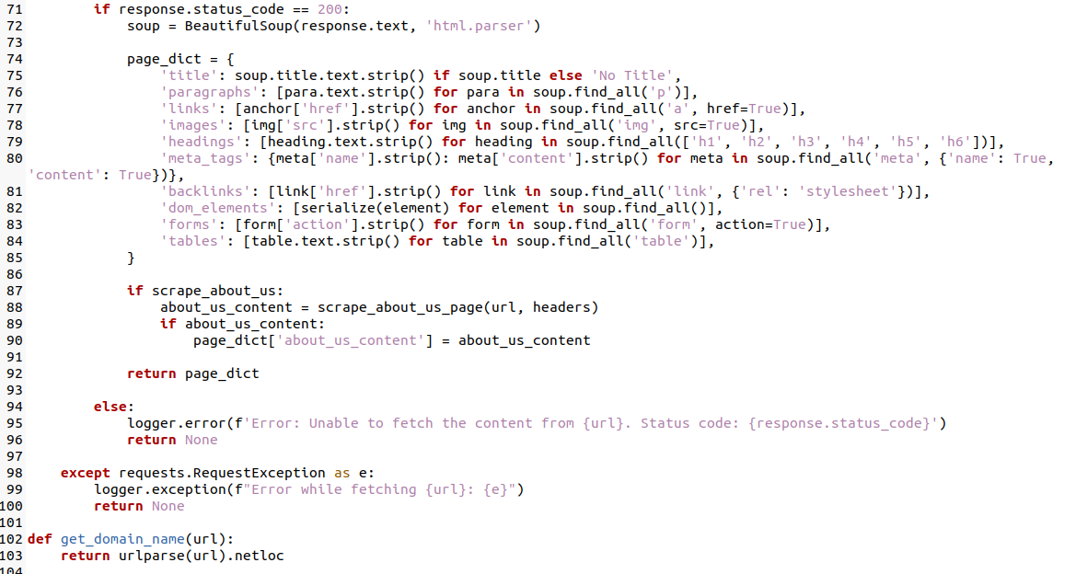
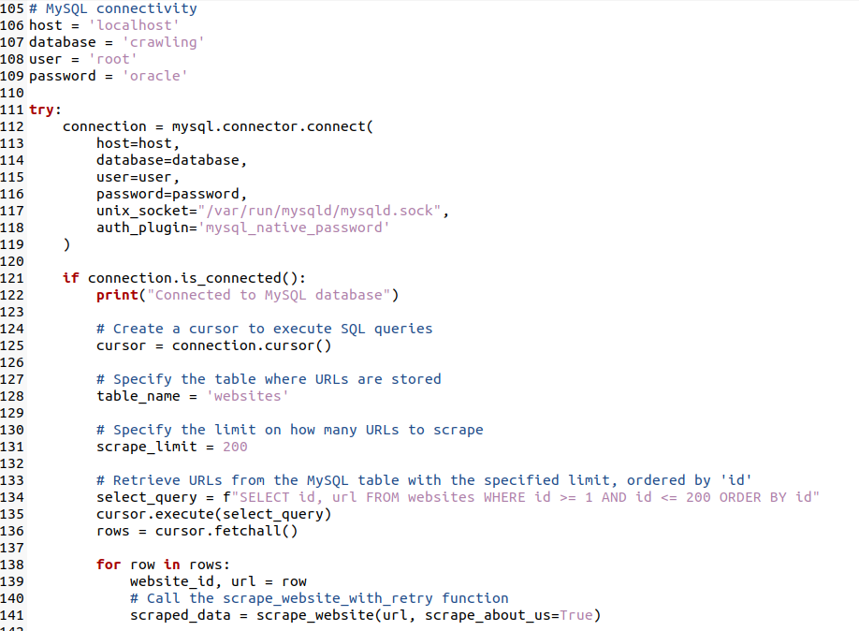
DATABASE CONNECTIVITY

Slide 20
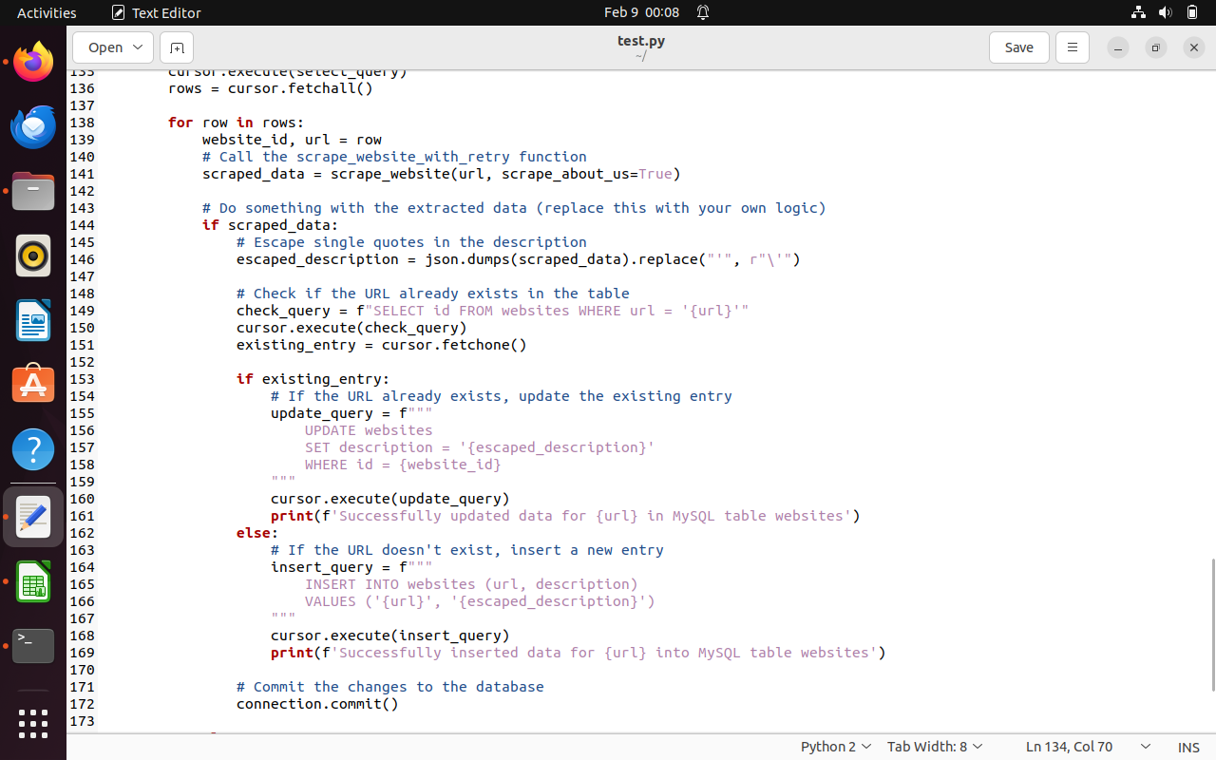
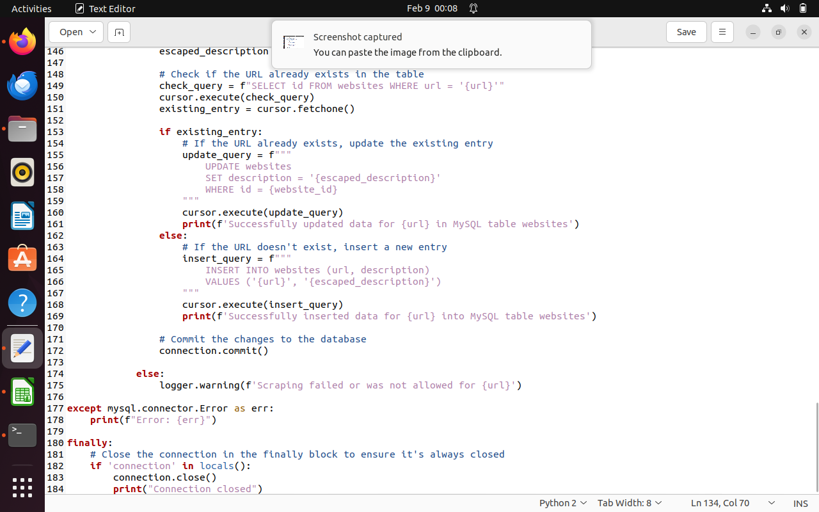
DATABASE CONNECTIVITY

Slide 21
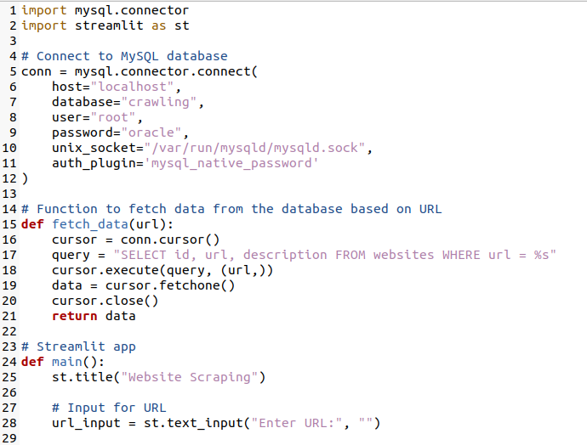
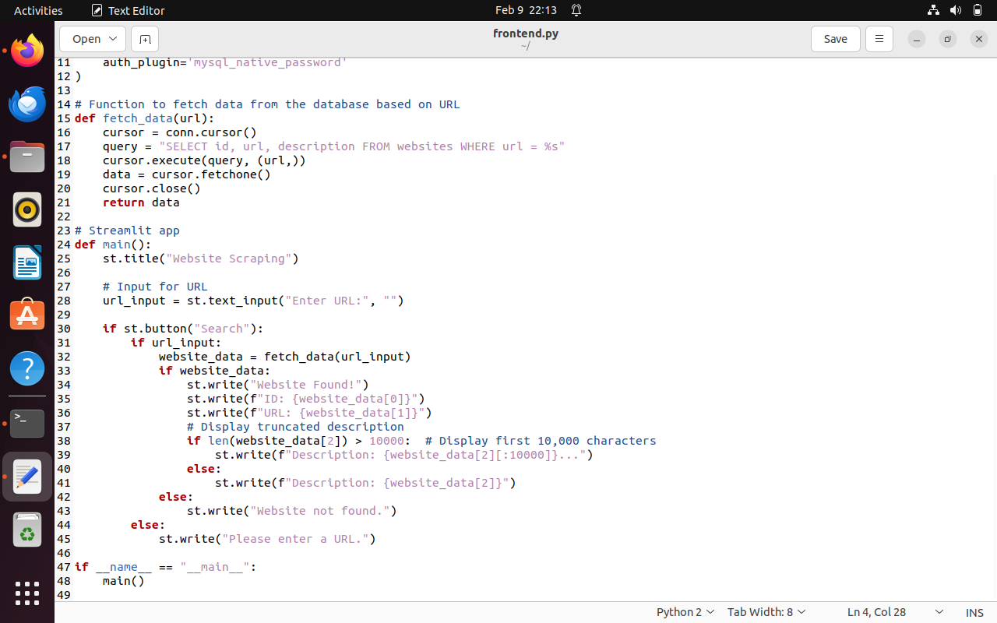
STREAMLIT CODE

Slide 22
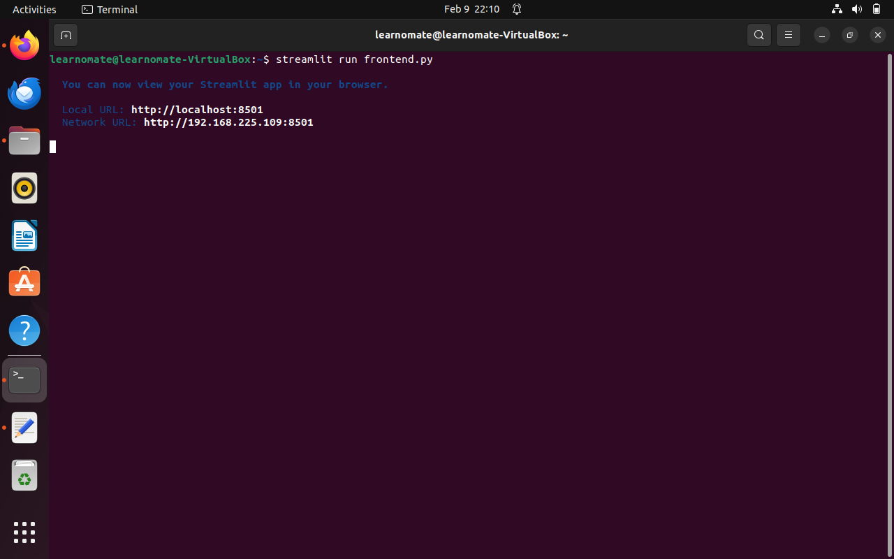
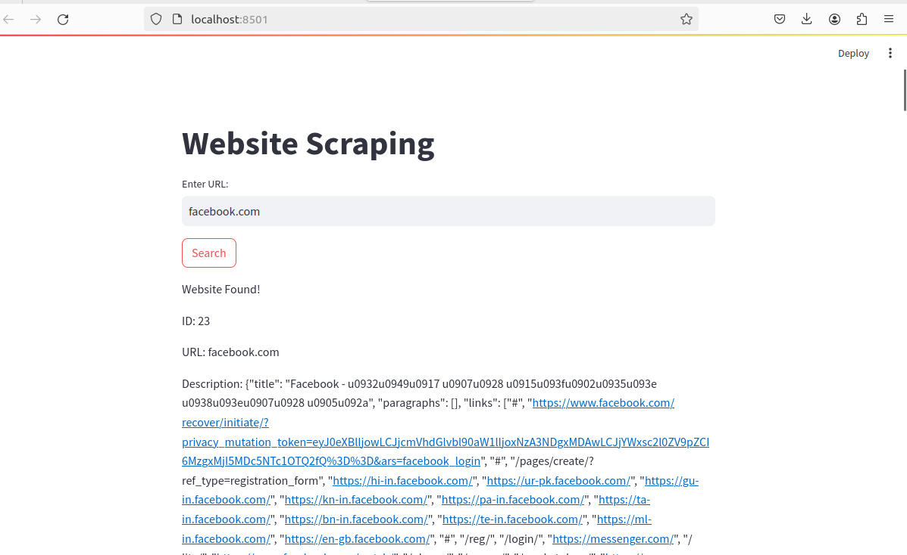
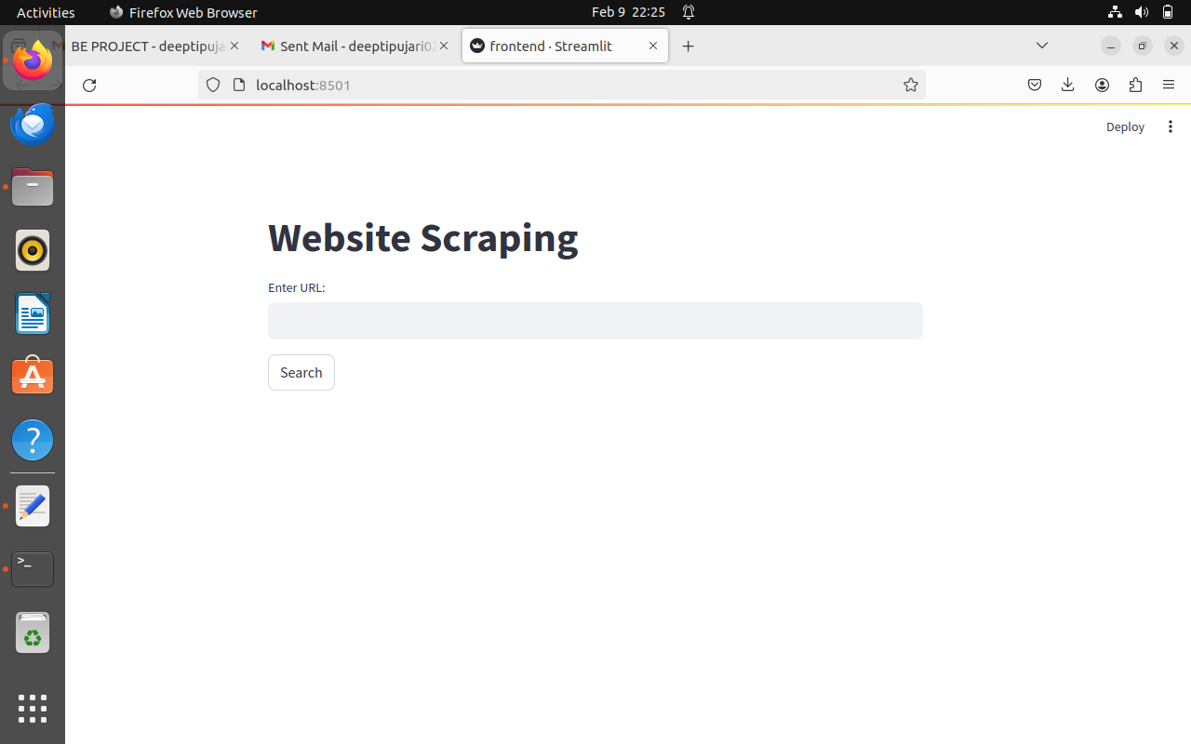
GUI

Slide 23
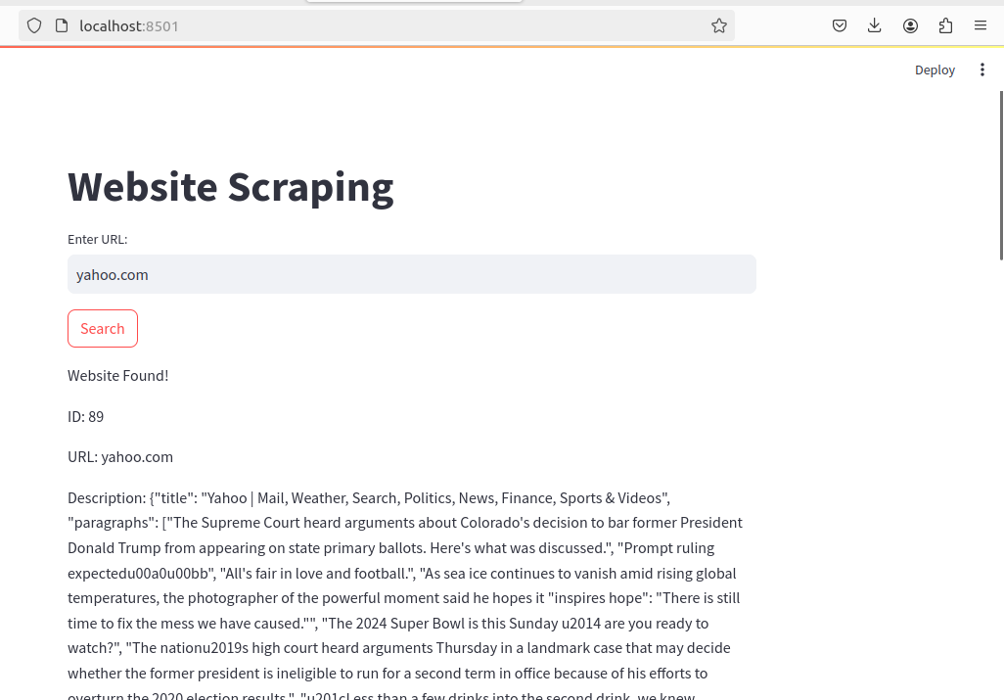
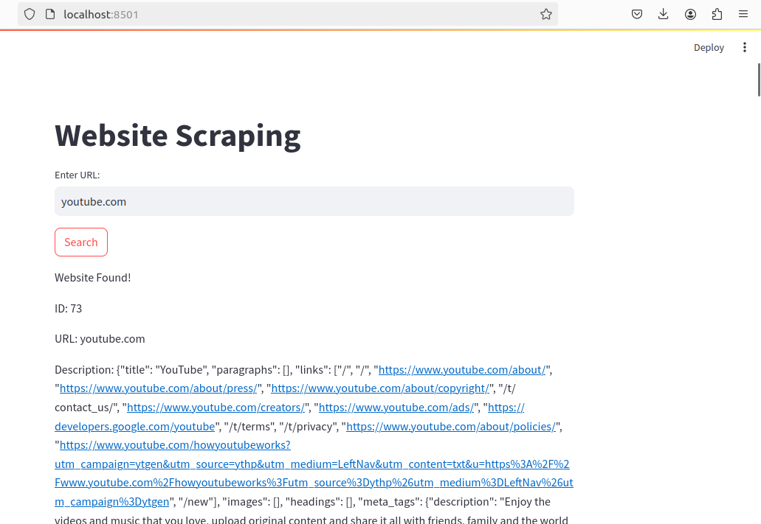
GUI

Slide 24
Conclusion
Our project provides a comprehensive solution for internet usage management, integrating web crawling, machine learning, and network control for dynamic website categorization.
The daily updated MySQL database ensures responsiveness, while the user-friendly GUI and adaptive network control enhance security and offer real-time flexibility for administrators.

Slide 25
References
[1] Vassiliki Hatzi, B. Barla Cambazoglu, and Iordanis Koutsopoulos “Green Web Crawling: Minimizing Energy Consumption and Carbon Emissions”, IEEE journal,2023
[2] JESPER BERGMAN AND OLIVER B. POPOV“Exploring Dark Web Crawlers: A Systematic Literature Review of Dark Web Crawlers and Their Implementation”, IEEE Access,2023
[3] BYUNG-WON ON 1 , JUN-YOUNG JO1 , HYUNKWANG SHIN2 , JANGWON GIM 1 , GYU SANG CHOI 2 , AND SOO-MOK JUNG3 “Efficient Sentiment-Aware Web Crawling with Hash-Based Methods”, IEEE Access,2021
[4] Moaiad Ahmad Khder“Web Scraping or Web Crawling: State of Art, Techniques, Approaches and Application”, Research Gate,2021
[5] Abdul Hadi M. Alaidi1, Roa’a M. Al_airaji2 , Haider TH. Salim ALRikabi3 , Ibtisam A. Aljazaery4 , Saif Hameed Abbood “Dark Web Illegal Activities Crawling and Classifying Using Data Mining Techniques”, Research Gate,2021
[6] SAWROOP KAUR AND G. GEETHA“Distributed Web Crawler for the Hidden Web”, IEEE Access,2020
[7] MILOS PAVKOVIC AND JELICA PROTIC “Structure-driven Incremental Forum Crawler (SInFo)”, IEEE Access,2019
[8] Bassel AlKhatib, Randa Basheer “Crawling the Dark Web: A Conceptual Perspective, Challenges and Implementation”, Research Gate,2019

Slide 26
THANK YOU!!!

